Slide 1


Preparing for LLMs
Video 1: Origin of Transformers

Slide 2
In Air

Slide 3

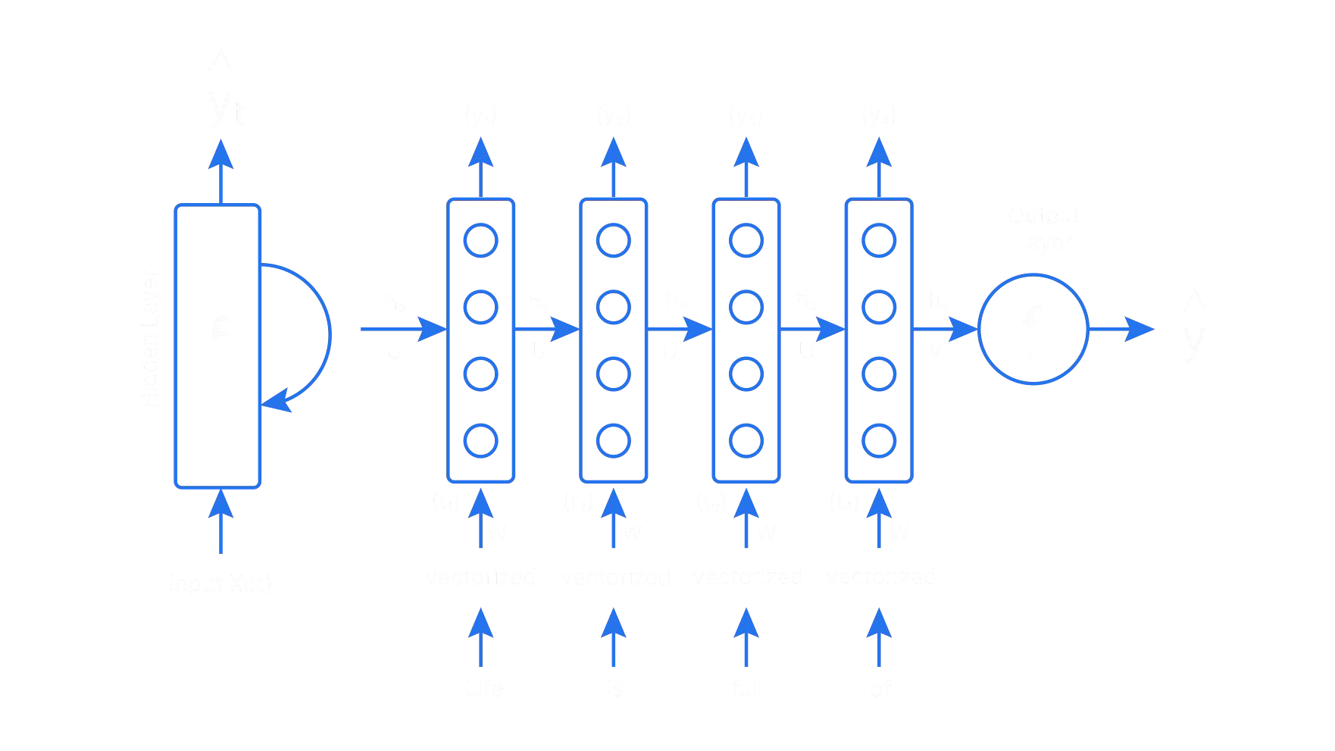
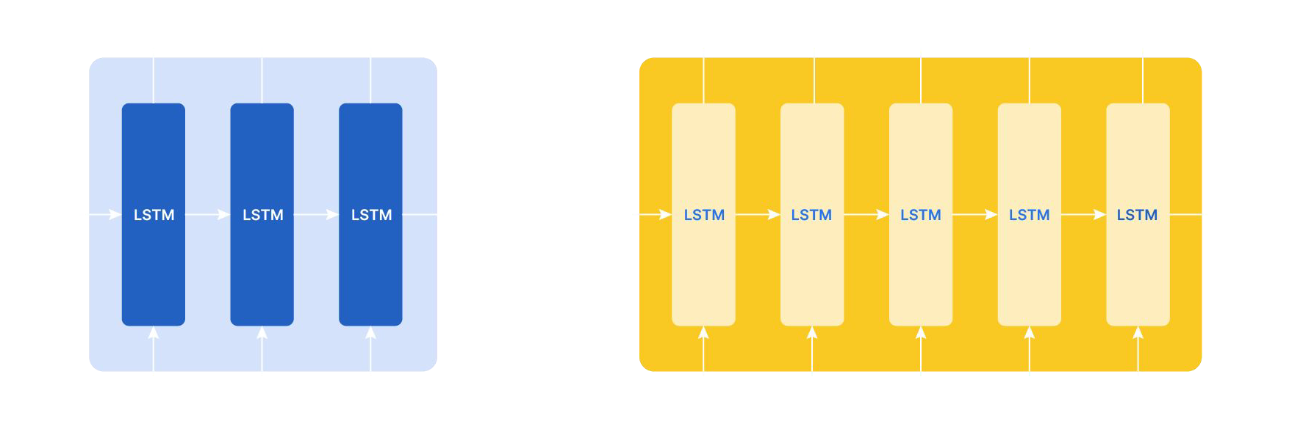
RNNs & LSTMs Era
2000 -
2014
RNNs and the LSTMs were the main techniques
w
h
W
h
w w w
h h y
x
x
x
x
RNNs
LSTM

Slide 4
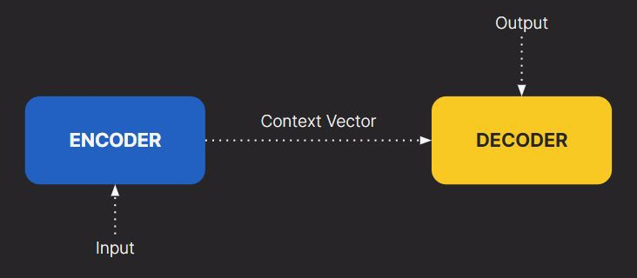
RKNeNysP&ubLlSicTaMtisonEsra
2000 -
2014
Introduced Encoder-Decoder Architecture: Sutskever, Vinyals, Le's "Sequence to Sequence Learning with Neural Networks” Paper
2014
Encoder-Decoder Architecture

Slide 5
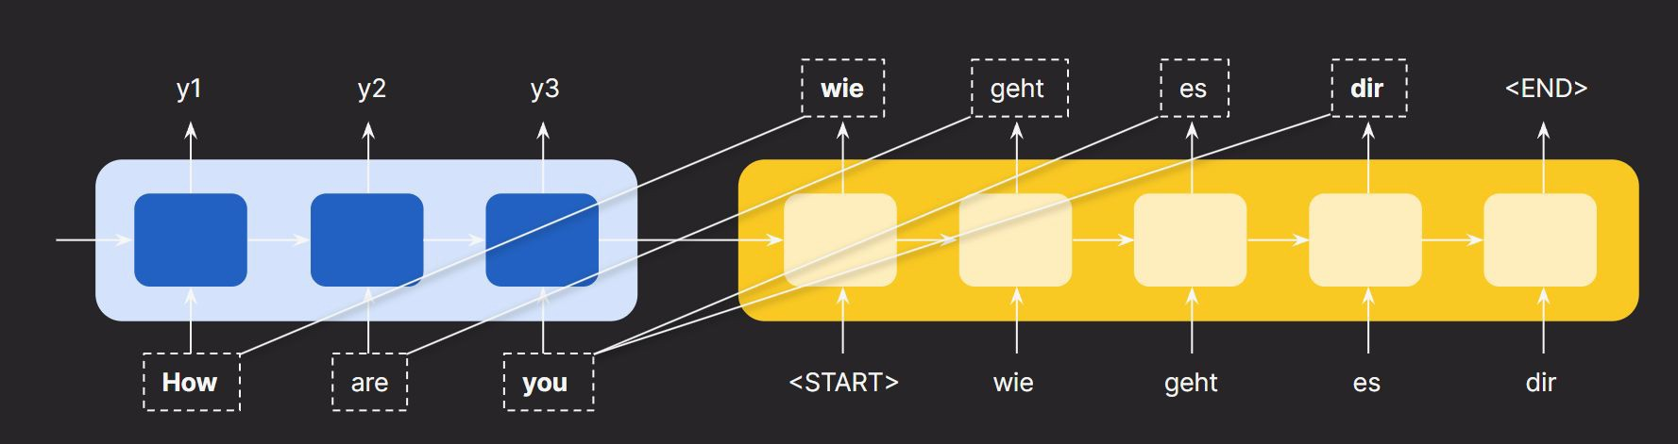
RKNeNysP&ubLlSicTaMtisonEsra
2000 -
2014
Introduced Attention Mechanism: Bahdanau, Cho, Bengio's “Neural Machine Translation by Jointly Learning to Align and Translate” Paper
2014
Attention Mechanism

Slide 6
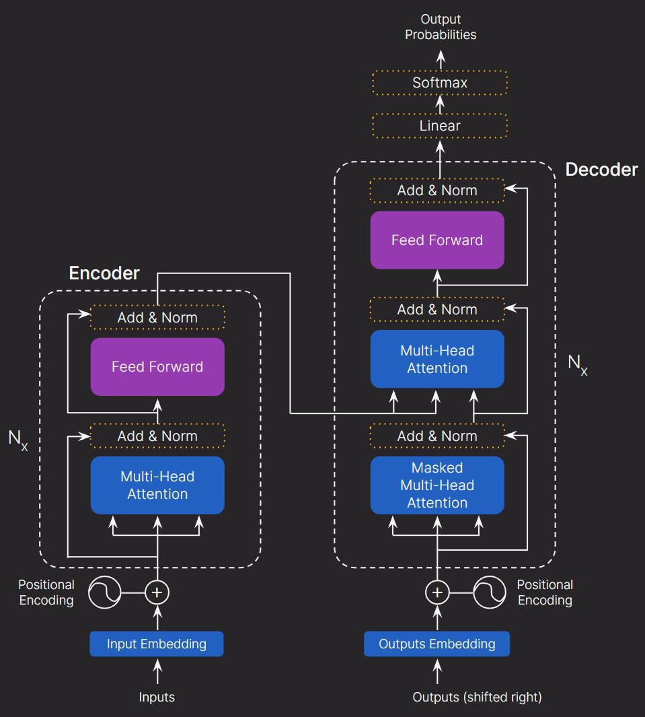
TRrKNaenNyssfoP&rumbLelSircTsaMLtiasounEnsrcah
2000 -
2014
Introduction of Transformer Model, "Attention Is All You Need" Ashish Vaswani, Noam Shazeer, Niki Parmar, Jakob Uszkoreit, Llion Jones, Aidan N. Gomez, Łukasz Kaiser, and Illia Polosukhin.
2014
2017
Positional
Positional
Embeddin
Embeddin
g
g

Slide 7


TRrKNaeBnNysEsfRoP&TrumbL&elSircGTsaPMLtTiasoun1Ensrcah
2000 -
2014
OpenAI's GPT Achieves State-of-the-Art in NLP
2014
BERT Emerges, Outperforming Other Models Across NLP Tasks
2017
2018

Slide 8
TRGrKNaPeBnNTysEsf-RoP2&Tru,mbL&TelSi5rcGTs,aPMBLtTiaEsouRn1EnTsrcsah
2000 -
2014
Release of GPT-2 with larger dataset and parameters
2014
RoBERTa: Improved BERT Version
2017
Google's ALBERT: Lighter, Enhanced Performance Model
2018
Google's T5: performs well on several NLP tasks.
2019

Slide 9

GPT -3
2020
GPT-3 Launch: Near-Human Text Generation with 175 Billion Parameters
GPT 3
Could generate logical & accurate language
Could producer original content

Slide 10
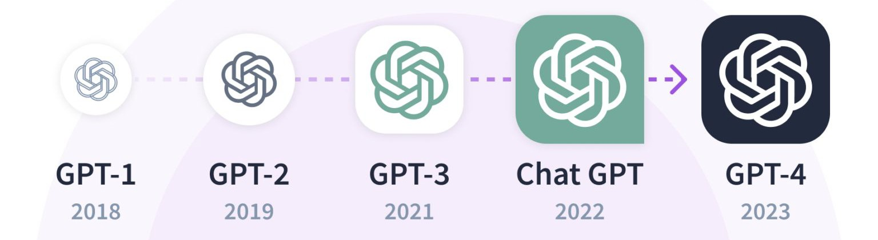
CGhPaTtG-P3T
2020
Release of GPT-3.5, followed by GPT-4
Frequent releases demonstrates ongoing research and expansion in AI field.
2022-24

Slide 11


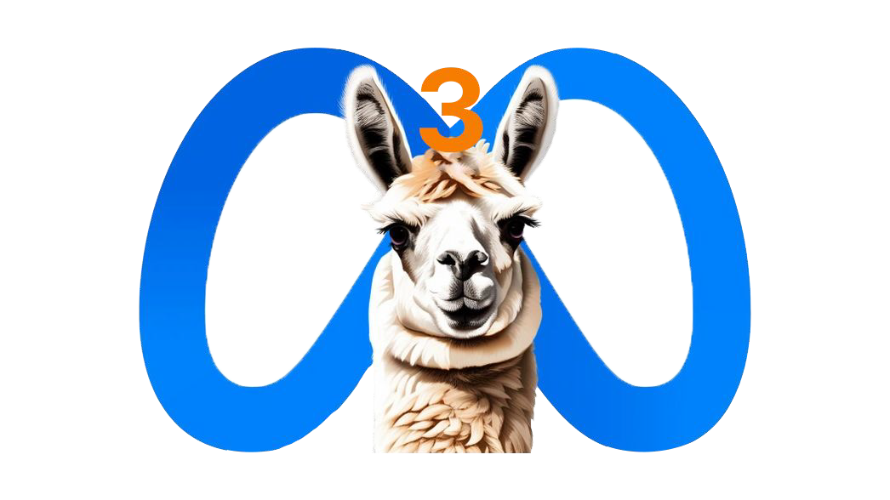
OCtGheParTtGL-LP3MTs
2020
2022-24
2023-24

Slide 12
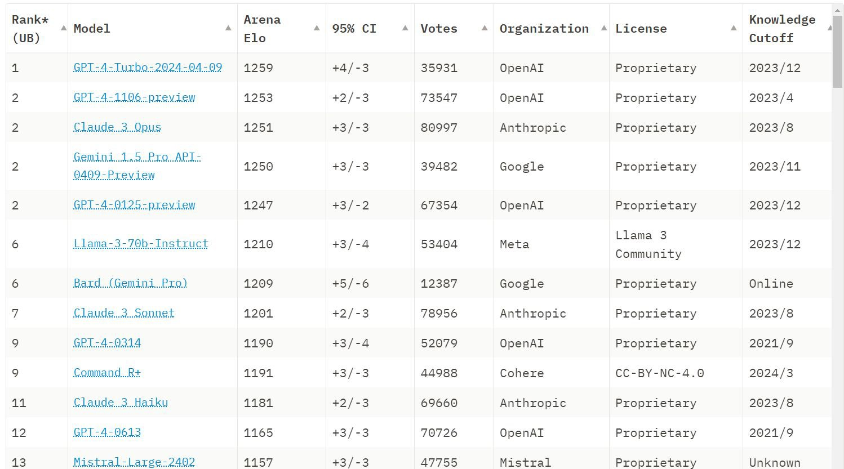
Leaderboard as of 5th May 2024
Link : https://huggingface.co/spaces/lmsys/chatbot-arena-leaderboard

Slide 13
In Air

